Slide 1
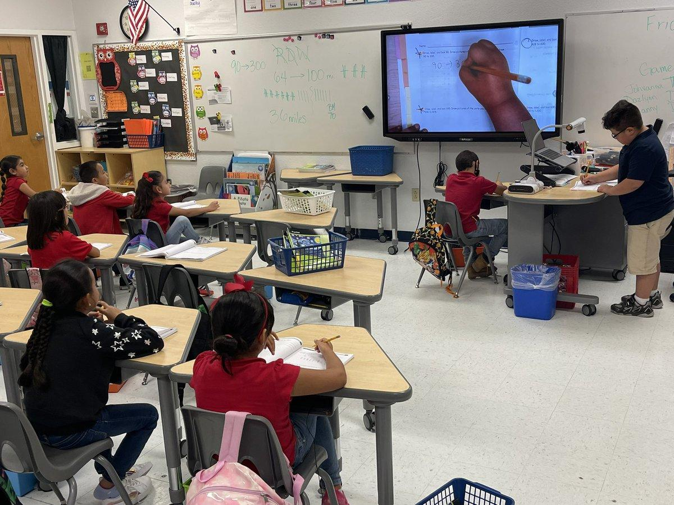
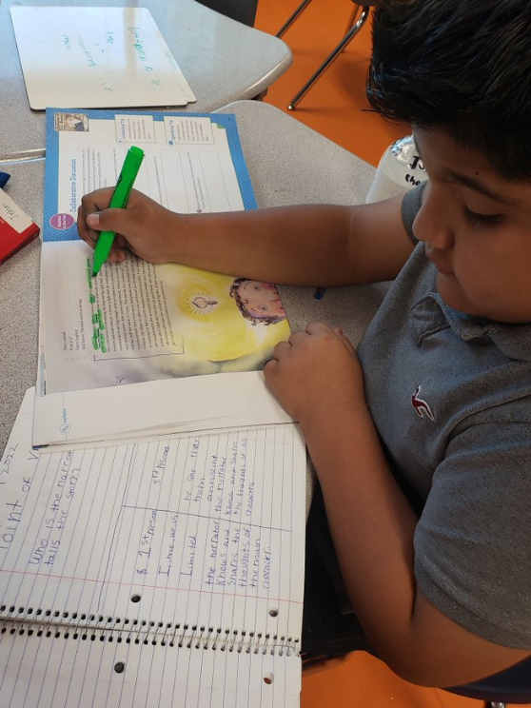
Early Math and Literacy Board Goals (RSSP)Progress Monitoring Update
September 2022

Slide 2
MISSION AND GOALS:
The mission of the Clint Independent School District is to prepare all students to be successful citizens.
The District will work in partnership with the community and the family to create opportunities for the student to maximize personal potential.
The District will be a model of high standards for student academic excellence.
The District will ensure a safe well-disciplined positive learning environment for all students.
The District will operate efficiently being fiscally responsible.
The District will become the employer of choice in order to seek and retain effective personnel.
The District will include parents, community, and business members in the education of all students.

Slide 3
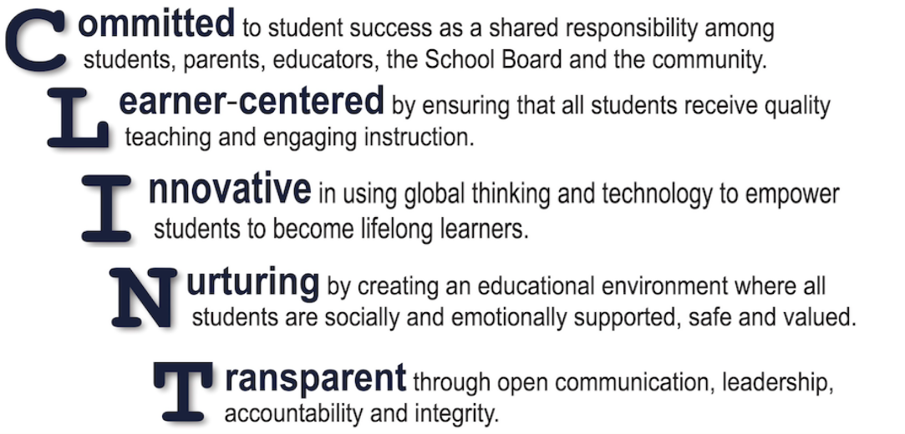
Core Values:

Slide 4
What Has Changed and What Has Stayed the Same?
Reading:
There have been no changes to our Board Goals for Reading with regard to our Progress monitoring tool. We are still using CLI Engage and MClass Dibels/Idel for PK-2nd grade screener and progress monitoring tool. However, we have increased some target goals based on our work with TCLAS and RSSP-Resilient Schools Support Program.
Math:
With our work within the TCLAS Grant, we have changed our Math screener from Dreambox to IReady which has been approved by TEA.

Slide 5
Table of Contents:
STAAR Elementary Cut Points
Pre- Kindergarten -Second Grade EOY Reading Review
Pre- Kindergarten -Second Grade EOY Math Review
Pre- Kindergarten -Second Grade 22-23 Reading Goals and Supports
Pre- Kindergarten -Second Grade 22-23 Math Goals and Supports

Slide 6
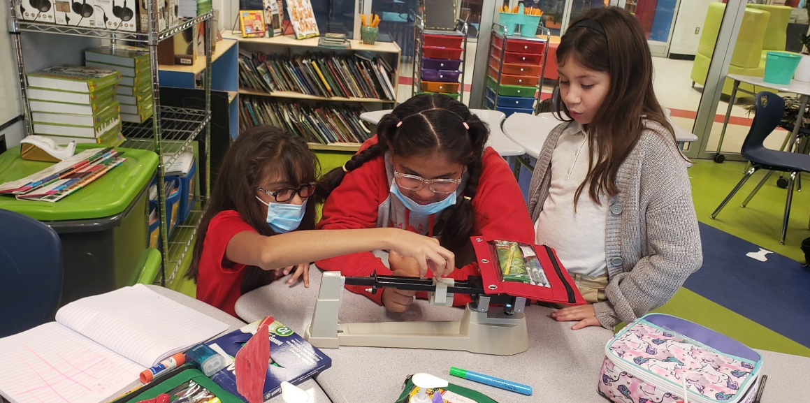
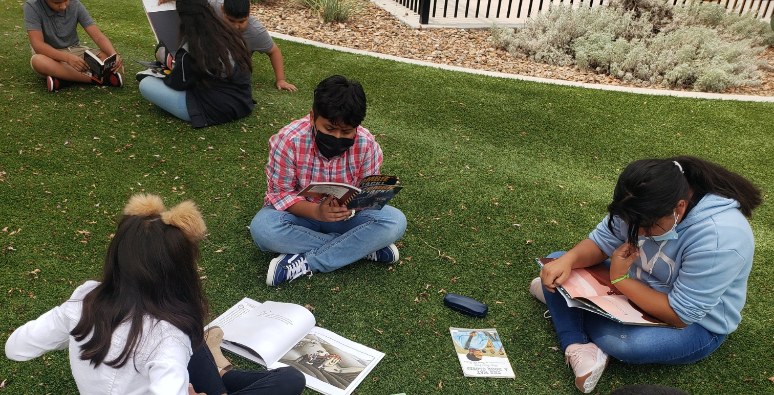
STAAR Elementary Cut Points
As of September 2022

Slide 7
90
60
30

Slide 8
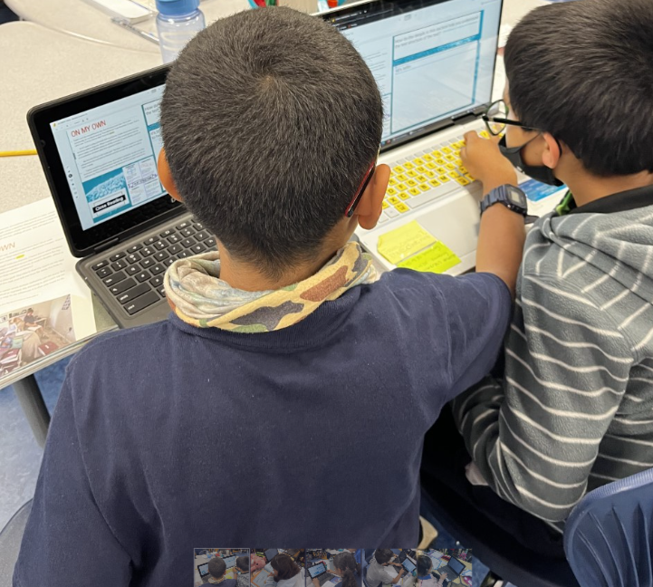
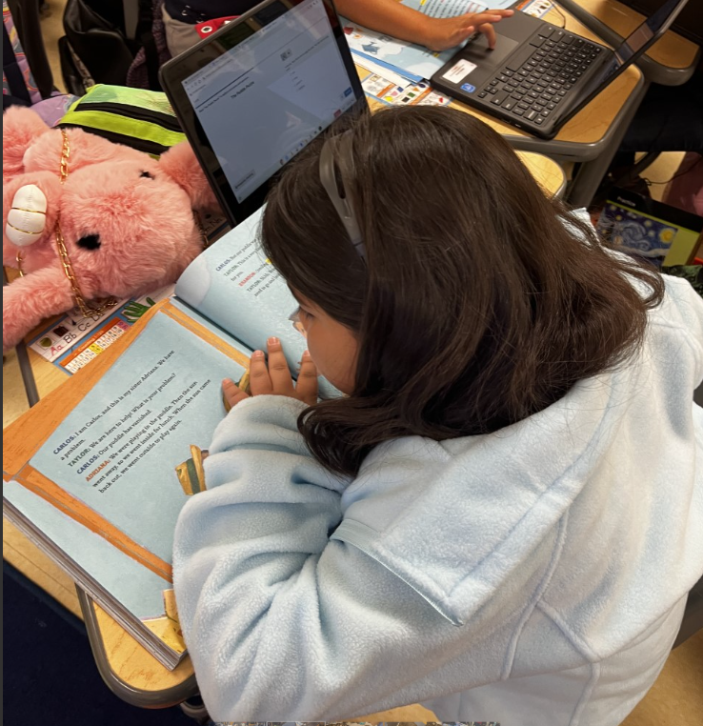
Pre-Kindergarten - Third Grade EOY Reading Review
EOY June 2022

Slide 9
Early Childhood Literacy Board Outcome Goal:
Early Childhood Literacy Board Outcome Goal
The percent of 3rd grade students that score meets grade level or above on STAAR Reading will increase from 36% (2018-2019) to 60% by June 2024.
Yearly Target Goals
2020 |  | 2021 |  |  | 2022 |  |  | 2023 |  |  | 2024
- |  | 44% |  |  | 49% |  |  | 55% |  |  | 60%
- |  | 13% |  |  | 36%
Our targets remain the same. If we continue to make the same gains this school year we could easily reach our 2024 target of 60%.

Slide 10
Board Outcome Progress Measures: Used in plan development and monitoring.
Progress Measure 1.1: The percent of Pre-K students that score ”On Track" on CLI-Engage reading will
increase from 59% to 71% by June 2024.
Yearly Target Goals
2020 | 2021 | 2022 | 2023 | 2024
- | 59% | 63% | 67% | 71%
EOY 2020-2021 | 65% | 76%
This target was surpassed. You will see in the 2022-23 goals that we have adjusted/increased our targets.

Slide 11
Board Outcome Progress Measures: Used in plan development and monitoring.
Progress measure 1.2: The percent of K students that score ”Benchmark or Above Benchmark" on
mCLASS Dibels-8 (English) and IDEL (Spanish) reading screeners will increase from 60% to 75% by
June 2024
Yearly Target Goals
2020 | 2021 | 2022 | 2023 | 2024
- | 60% | 65% | 70% | 75%
EOY 2020-2021 | 37% | 53%
16% gain from 2021 to 2022. Our target goals will remain the same.

Slide 12
Board Outcome Progress Measures: Used in plan development and monitoring.
Progress Measure 1.3:The percent of 1st-3rd grade students that score ”Benchmark or Above Benchmark" on mCLASS Dibels-8 (English) and IDEL (Spanish) reading screeners will increase from 55% to 75% by June 2024.
Yearly Target Goals
2020 | 2021 | 2022 | 2023 | 2024
- | 55% | 62% | 69% | 75%
EOY 2020-2021 | 51% | 53%
Combined 2% gain from 2021 to 2022. Our target goals will remain the same.

Slide 13
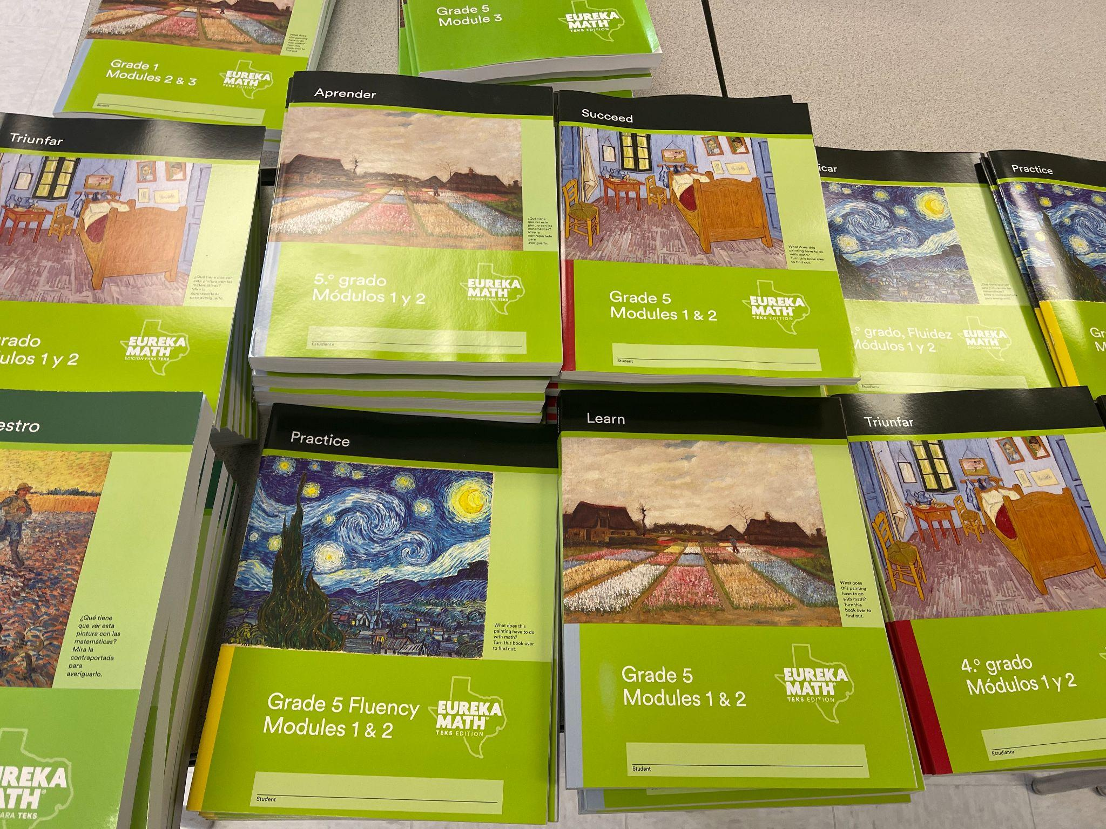
Pre-Kindergarten - Third Grade EOY Math Review
EOY June 2022

Slide 14
Early Childhood Math Board Outcome Goal:
Early Childhood Math Board Outcome Goal
The percent of 3rd grade students that score meets grade level or above on STAAR Math will increase from 53% to 65% by June 2024.
Yearly Target Goals
2020 |  | 2021 |  |  | 2022 |  |  | 2023 |  |  | 2024
- |  | 53% |  |  | 57% |  |  | 60% |  |  | 65%
 |  | 8% |  |  | 28%
20% gain from 2021 to 2022. Our target goals will remain the same. Math across the state of Texas was impacted the most at the elementary level.
Notes:
35% Approaches

Slide 15
Board Outcome Progress Measures: Used in plan development and monitoring.
Progress Measure 1.1: The percent of Pre-K students that score ”On Track" on CLI-Engage Math will increase from 62% to 74% by June 2024.
Yearly Target Goals
2020 | 2021 | 2022 | 2023 | 2024
- | 62% | 66% | 70% | 74%
EOY 2020-2021 | 87% | 84%
We had a slight decline from 2021-2022 but still surpassed our goals. These targets will be adjusted for the 2022-2023 school year.

Slide 16
Board Outcome Progress Measures: Used in plan development and monitoring.
Progress measure 1.2: The percent of K students that score “On- Track ” on Dreambox math will increase from 70% to 85% by June 2024.
Yearly Target Goals
2020 | 2021 | 2022 | 2023 | 2024
- | 70% | 75% | 80% | 85%
EOY 2020-2021 | 55% | 41%
We had a 14% decline in Dreambox performance from 2021 to 2022 in spite of our increase in usage.

Slide 17
Board Outcome Progress Measures: Used in plan development and monitoring.
Progress Measure 1.3:The percent of 1st-3rd grade students that score ”Ontrack" on Dreambox math will increase from 60% to 75% by June 2024.
Yearly Target Goals
2020 | 2021 | 2022 | 2023 | 2024
- | 60% | 65% | 70% | 75%
EOY 2020-2021 | 34% | 40%
We had a combined 6% increase in our Dreambox performance from 2021-2022.

Slide 18
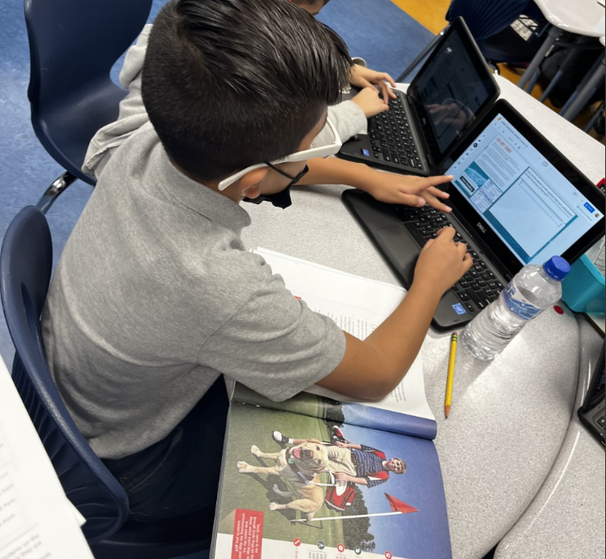
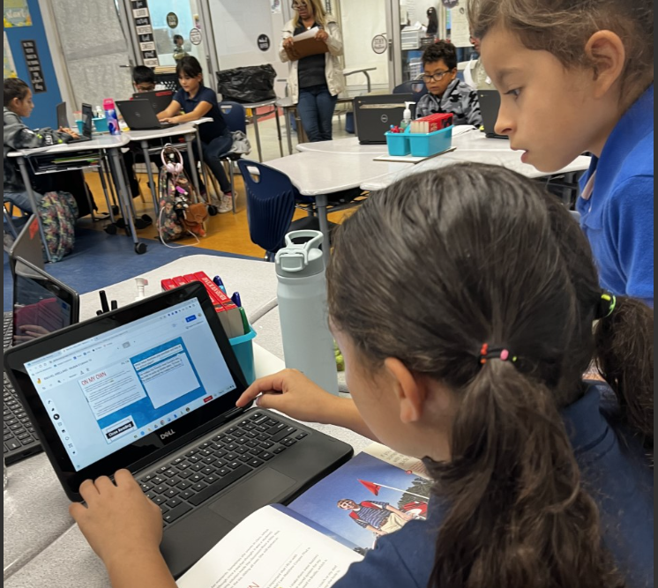
Pre-Kindergarten - Second Grade 2022-2023 Reading Goals & Supports
September 2022

Slide 19
Early Childhood Literacy Board Outcome Goal:
Early Childhood Literacy Board Outcome Goal
The percent of 3rd grade students that score meets grade level or above on STAAR Reading will increase from 36% (2018-2019) to 60% by June 2024.
Yearly Target Goals
 |  |  | 2022 |  |  | 2023 |  |  | 2024
EOY Goal |  |  | 49% |  |  | 55% |  |  | 60%
EOY 2021-2022 |  |  | 36%

Slide 20
Board Outcome Progress Measures: Used in plan development and monitoring.
Progress Measure 1.1: The percent of Pre-K students that score ”On Track" on CLI-Engage reading will
increase from 59% to 85% by June 2024.
Yearly Target Goals
 | 2022 | 2023 | 2024
EOY Goal | 63% | 80% | 85%
EOY 2021-2022 | 76%
Notes:
Based on the TSL document

Slide 21
Board Outcome Progress Measures: Used in plan development and monitoring.
Progress measure 1.2: The percent of K students that score ”Benchmark or Above Benchmark" on
mCLASS Dibels-8 (English) and IDEL (Spanish) reading screeners will increase from 60% to 75% by
June 2024
Yearly Target Goals
 | 2022 | 2023 | 2024
EOY Goal | 65% | 70% | 75%
EOY 2021-2022 | 53%

Slide 22
Board Outcome Progress Measures: Used in plan development and monitoring.
Progress Measure 1.3:The percent of 1st grade students scoring ”Benchmark or Above Benchmark" on mCLASS Dibels-8 (English) and IDEL (Spanish) reading screeners will increase to 78% by June 2024.
Yearly Target Goals
 | 2023 | 2024
EOY Goals | 70% | 75%
EOY 2021-2022 | 51%

Slide 23
Board Outcome Progress Measures: Used in plan development and monitoring.
Progress Measure 1.3:The percent of 2nd grade students that score ”Benchmark or Above Benchmark" on mCLASS Dibels-8 (English) and IDEL (Spanish) reading screeners will increase from 62% to 70% by June 2024.
Yearly Target Goals
 | 2023 | 2024
EOY Goals | 65% | 70%
EOY 2021-2022 | 56%
Notes:
Add the average of 2nd and 3rd- 686/1317 = 52%
Second - 56% Benchmark or Above
Third - 53% Benchmark or Above
Avg.

Slide 24
RLA Next Steps:
Supports | Student Learning Impact
Explicit & Systematic Phonics Instruction | By implementing a systematic phonics scope and sequence, reading foundational instruction will be grounded in research based progression of learning to read. Explicit instruction will provide students with clear and precise instruction that will allow student to apply their reading foundational skills in isolation and within context
Aligned K-5 High Quality Instructional Materials | Provides an explicit and systematic phonic scope and sequence with embedded supports Provide students access to high quality grade level and/or complex text Supports students with using reading skills to build knowledge about real world concepts Allows students to practice using text evidence to discuss literature and/or informational text
NTC RLA Best Practice | A professional development session that focused on learning about research based instructional strategies that are used to teach RLA instruction to yield lifelong readers.

Slide 25
RLA Next Steps:
Supports | Student Learning Impact
Addition Amplify Lectura | Amplify Lectura is a computer adaptive personalized instruction software that will support providing students opportunities to practice reading foundational skills based on the students individualized needs Amplify Lectura is used in the dual language program to support the Spanish component of the 50/50 model
Intervention/ Acceleration | The intervention block will focus on providing a blended learning environment that includes small group instruction focusing on RLA skills (K-2 foundational skills /3-5 comprehension skills)
Lesson Internalization | Teachers will be able to add supports and differentiation specific to the students’ needs to research based and aligned lessons provided in the HQIM (moving from planning to prepping)

Slide 26
Pre-Kindergarten - Second Grade 2022-2023 Math Goals & Supports
September 2022

Slide 27
Early Childhood Math Board Outcome Goal:
Early Childhood Math Board Outcome Goal
The percent of 3rd grade students that score meets grade level or above on STAAR Math will increase from 28% to 65% by June 2024.
Yearly Target Goals
 |  |  | 2022 |  |  | 2023 |  |  | 2024
EOY Goal |  |  | 57% |  |  | 60% |  |  | 65%
EOY 2021-2022 |  |  | 28%
Notes:
35% Approaches

Slide 28
Board Outcome Progress Measures: Used in plan development and monitoring.
Progress Measure 1.1: The percent of Pre-K students that score ”On Track" on CLI-Engage math will increase from 87% to 90% by June 2024.
Yearly Target Goals
 | 2023 | 2024
EOY Goal | 87% | 90%
EOY 2021-2022 | 84%
*This target changed in 2023 and 2024 due to surpassing the 2022 goal.

Slide 29
Board Outcome Progress Measures: Used in plan development and monitoring.
Progress measure 1.2: The percent of K students that score “Approaches/On Grade Level” on i-Ready Math will increase from 80% to 85% by June 2024.
Yearly Target Goals
 | 2023 | 2024
EOY Goal | 80% | 85%
EOY 2021-2022 | -
Notes:
BOY - 96% approaches 3% early on grade level - 3%= 99%. BOY meets the 2023 AND 2024 goal

Slide 30
Board Outcome Progress Measures: Used in plan development and monitoring.
Progress Measure 1.3:The percent of 1st grade students that score “Approaches/On Grade Level” on i-Ready math will increase from 70% to 75% by June 2024.
Yearly Target Goals
 | 2023 | 2024
EOY Goal | 70% | 75%
EOY 2021-2022 | -
Notes:
BOY - 64% approaches early on grade level - 2%= 66%. BOY data is 4% short of the EOY goal

Slide 31
Board Outcome Progress Measures: Used in plan development and monitoring.
Progress Measure 1.3:The percent of 2nd grade students that score “Approaches/On Grade Level” on i-Ready math will increase from 70% to 75% by June 2024.
Yearly Target Goals
 | 2023 | 2024
EOY Goal | 70% | 75%
EOY 2021-2022 | -
Notes:
2nd - 40% approaches early on grade level 2% = 42%
3rd - 49% approaches early on grade level 6% = 55%
2nd- 3rd BOY 49% (avg. of 2nd and 3rd approaches early on grade level) 21% short from the 2023 EOY Goal

Slide 32
Math Next Steps:
Supports | Student Learning Impact
Aligned K-5 High Quality Instructional Materials | Provide opportunities for student to learn math with the conceptual, procedural and abstract to ensure students have an in depth of the mathematical concepts Students are able to apply their learning with aligned assessments
Intervention/ Acceleration | The intervention block will focus on providing a blended learning environment that includes small group instruction focusing on math skills to meet the specific needs of the students IReady Interventions will be utilized during intervention and is targeted to the students’ needs.
NTC Math Best Practice | A professional development session that focused on learning about research based instructional strategies that are used to teach math instruction to ensure students are able to learn mathematical concepts through the lens of the conceptual, procedural and abstract

Slide 33
Math Next Steps:
Supports | Student Learning Impact
TEA HQIM Learning Modules | District, campus leadership and teachers participate in attending virtual modules that focus on key concepts within coaching and/or implementing the HQIM with fidelity
Lesson Internalization | Teachers will be able to add supports and differentiation specific to the students’ needs to research based and aligned lessons provided in the HQIM (moving from planning to prepping)

Slide 34
TCLAS Supports
Supports | Student Learning Impact
TCLAS Decision 1 COVID Recovery and Learning Acceleration Plan | Supports K-1 RLA instruction by implementing the following: RSSP Task Force Committee (district and campus representation) Review multiple data points (quantitative and qualitative) to identify RLA needs (K-1 all campuses was identified) Goals and Measurement Plan was created to measure the progress of RLA instruction within K-1
Residency Program | Provide laser focus on job embedded training and coaching for new teachers who are graduates from the UTEP Education Program New teachers will be supported by an assigned mentor teacher at the campus and district support with a partnership with UTEP and US Prep
High Impact Tutoring Program | Afterschool high impact tutoring will support 3rd -5th grade students within the following: 1 hour of high impact tutoring focusing on RLA and Math 1:3 Tutor to student ratio 2 hours of enrichment with the supports of Texas A&M Hands on enrichment such as cooking, health and wellness and SEL development

